Slide 1
INTRODUCTION
TOPICS WE WILL COVER
Cyber security and cryptography - we will learn the key concepts of CIA(Confidentiality, Integrity and Availability) and how cryptography concepts also tie in the picture
Cyber Threats- we will learn cyber threats affect our computer and how to mitigate them.
History of Ethical Hacking- we will learn how it began and the Massachusetts of Institute of Technology
Fundamentals of Networking and Ethical Hacking- we will learn the various tools that are used in ethical hacking and the network architectures that these tools are used in.
Ethical hacking using Kali Linux- we will learn about this tool. It is commonly used by ethical hackers or penetration testers; We will learn how to install it in our local machines, tools that come along with it and ways we should be using them.
Penetration testing- this is a subset of ethical hacking, We will learn about Metasploit, using it to learn about vulnerability analysis and how to install backdoors in different computer systems and take advantage of the vulnerabilites.
Nmap- we will learn how to use this tool to gather information from our networks and how to use this information to our advantage.
Cross-site scripting attack(XSS).
Distributed denial of Service(DDoS)
SQL Injection attacks. We will do these 3 attacks and how they are orchestrated and how we will mitigate them
Steganography- an advanced cryptography method; it is used to hide digital code inside images.
Ethical hacker roadmap - How to become an ethical hacker, job profiles that are there in the industry, companies hiring for these job profiles and their salaries.
Interviews question- we will see common interview questions that come along with these job profiles.

Slide 2
Basics of Cybersecurity
We will discuss on:
Why we need cybersecurity
What is cyber security
The CIA triad
Vulnerability, threat and risk
Cognitive cyber security

Slide 3
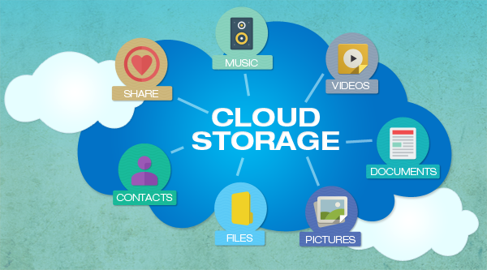
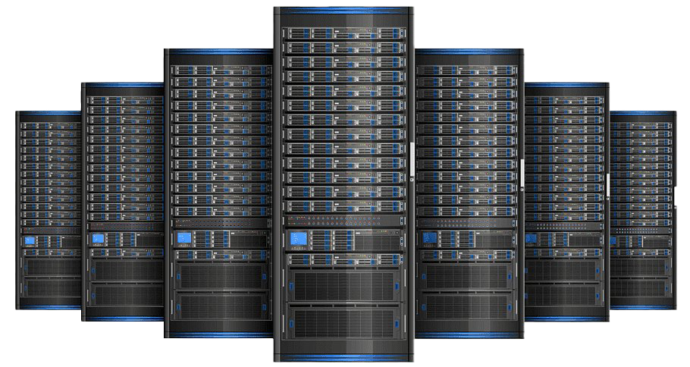
Why we need Cyber Security
We are living in a digital era: whether booking a hotel room or ordering some dinner or booking a cab, we are using the internet and generating data. This data is stored on the cloud, which is a huge data server/center that you can access online. We also use an array of devices to access this data.
Data Center
For an hacker it’s a golden age with so many access points public IP Addresses and constant traffic and tons of data to exploit black hat hackers are having one hell of a time exploiting vulnerabilities and creating malicious software for the same
Cyber attacks are evolving by the day and hackers are becoming smarter and more creative with their malwares and how they bypass virus scans and firewalls

Slide 4
CYBER THREATS
Types of Cyber Attacks
Malware- this is a code with malicious intent that typically steals data or destroys something on the computer.
Phishing- often poses as a request for data from a trusted third party, these attacks are sent via email and ask users to click on a link and enter their personal data.
Password attacks
DDoS
Man In The middle attack
Drive-By Downloads
Maladvertising
Rogue Software

